Slide 1

VATES
Owen Arnold, Michael Reuter, Alex Buts, Martyn Gigg, Andrei Savici, Nick Draper

Slide 2
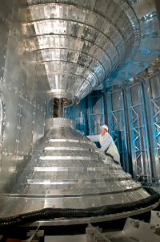
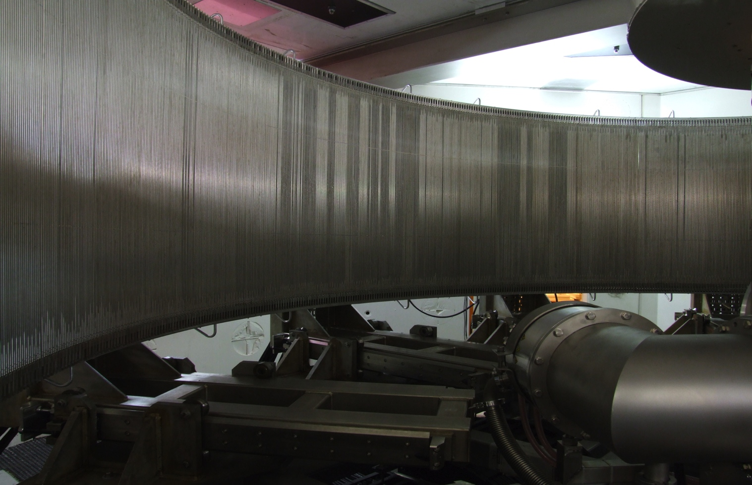
VATES : The problem
Highly pixelated instruments
Large data volumes
Many dimensions of interest
Need for n-dimensional data manipulation
One workbench required
760 tubes
x 128 pixels
x 5000 time channels =
450 Mb per run!
160º
+/- 15º

Slide 3
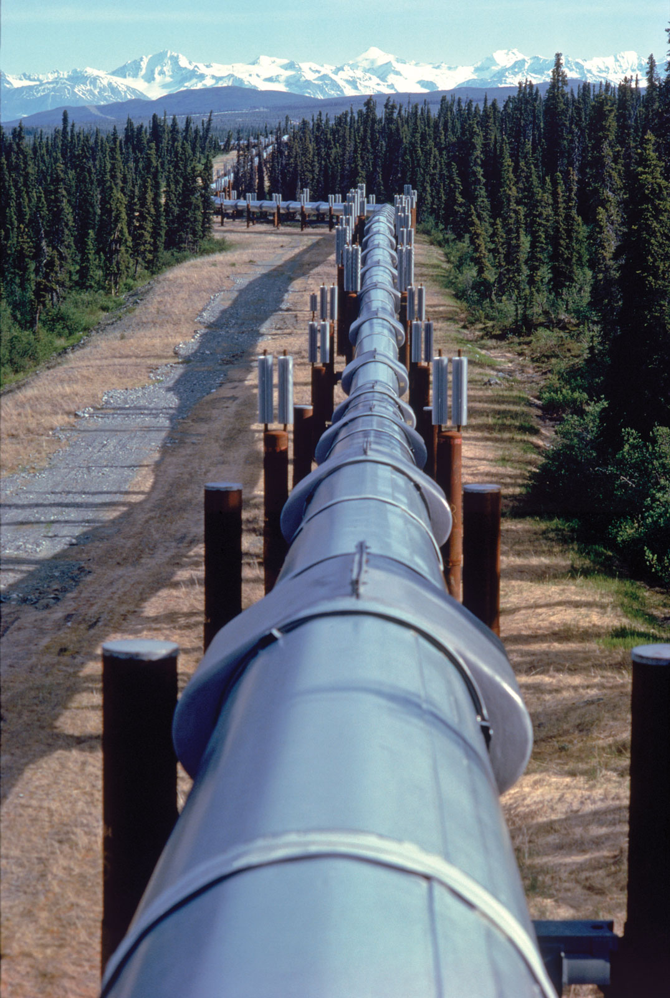
VATES : Requirements
Containers and pipeline for multi-dimensional data
Visualisation of multi-dimensional data
Simulation and fitting of multi-dimensional data
Pluggable/Extendable in many ways
Notes:
Containers and processing algorithmic steps are required for multidimensional data. We need flexibility both in terms of the dimensionality of the data, and the ability to change and adapt the pipelines we assemble.
We need the ability to both support Histogrammed data, and Sparse data effectively in a multidimensional format. We need the ability to easily perform common operations on the data, such as addition and subtraction, merging, rebinning etc.
We need the ability to visualize multidimensional data at any point, and also the ability to drive algorithmic steps in the visualisation mode in-situ.
We need the ability to simulate multidimensional data and to provide fitting features.
All this should work cross platform and be supported with regular releases.

Slide 4
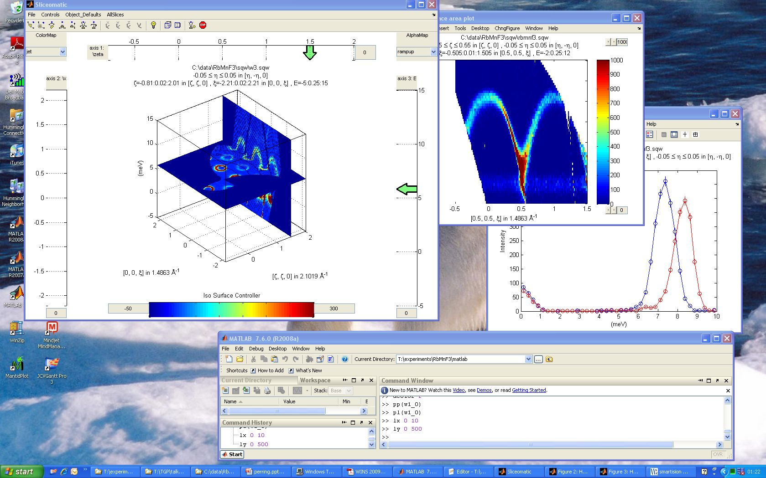
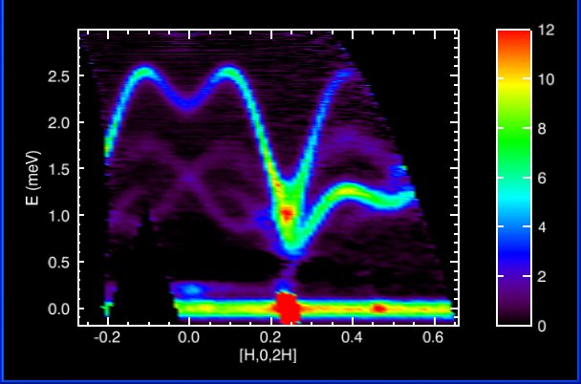
Previous and Existing Tools
Many successful tools to draw ideas from and extend
Notes:
The community has provided a lot of good and successful tools. Horace, Tobyfit, Mslice, Dave, Isaw and others have all been used to steer the development. We have also been fortunate enough to have input from some of the developers of these tools at various points in the project.

Slide 5
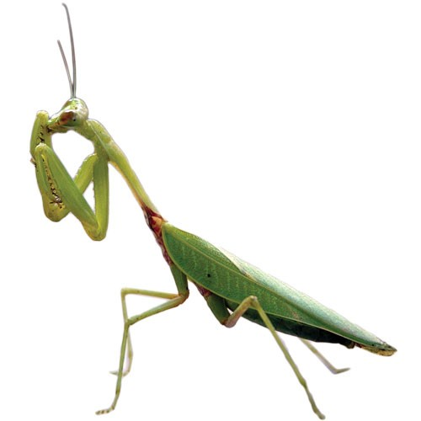
Platform Design Choice: Mantid
Mantid: Instrument and technique independent Data Reduction and Analysis.
Joint project by ISIS and SNS
Overlap in target platforms
Overlap in common functionality
Assemble one continuous chain
Shared maintenance effort
No need for another standalone tool
Notes:
Our primary design choice as a platform for the work has been Mantid.
Joint project that started running in 2007, with the SNS joining the collaboration in 2010.
The Mantid project was appealing particularly because:

Slide 6
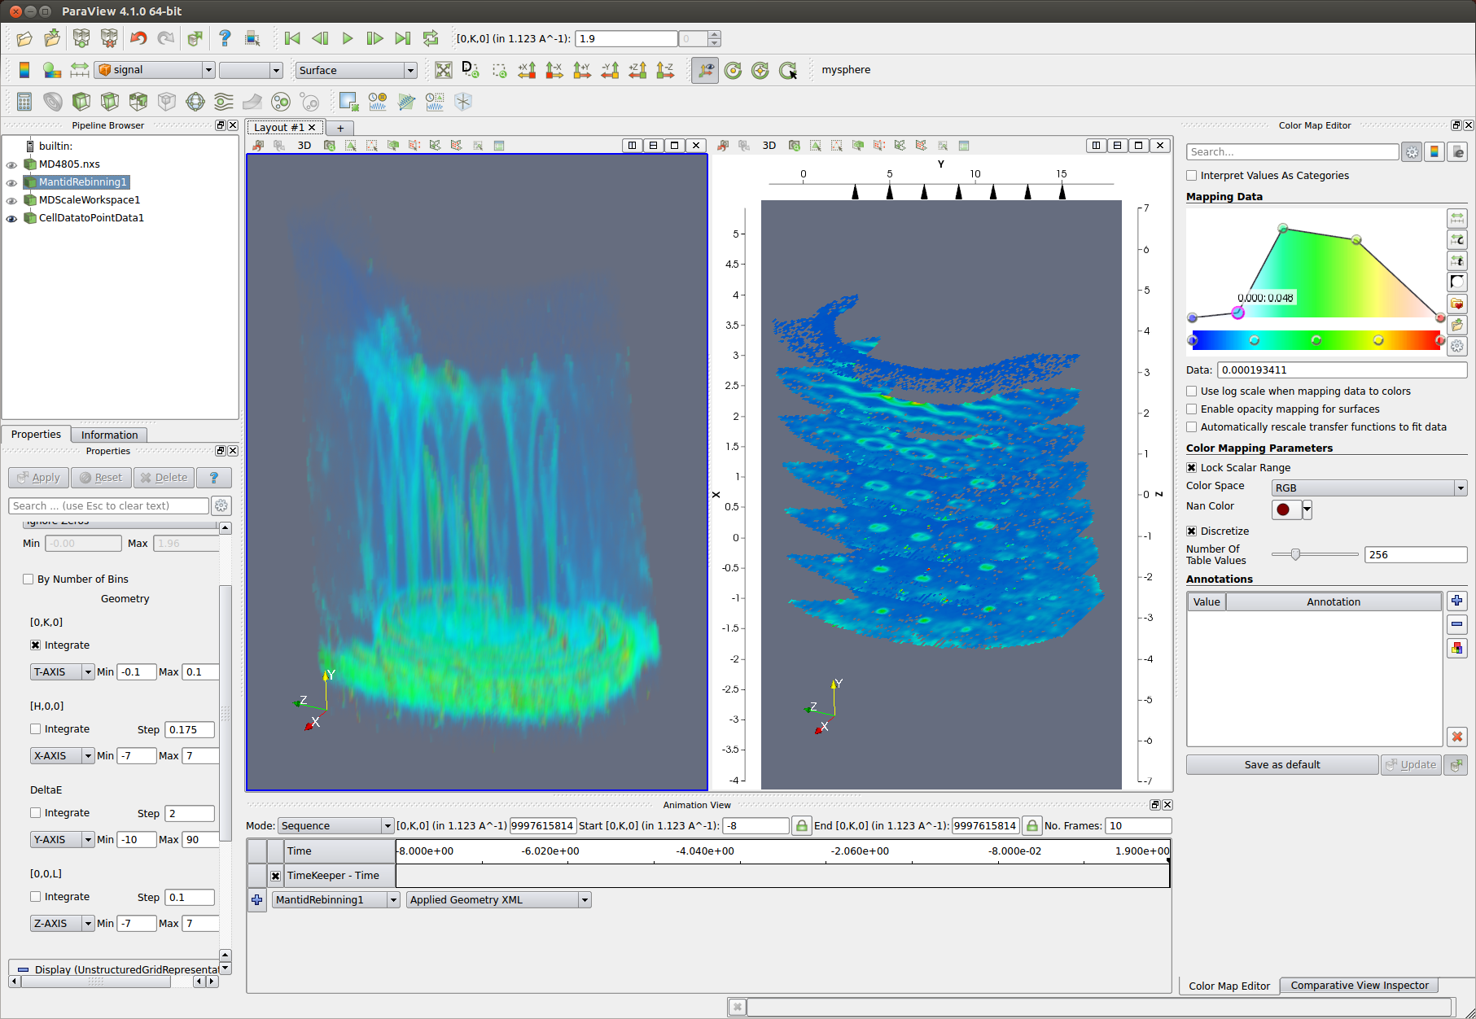
Platform Design Choice: ParaView
Cross-platform
Well supported
Open source
Pipeline branching
Suitable for large volumes of data
Notes:
Another design choice has been to use ParaView. ParaView is a mature technology that has been developed as a collaboration between KitWare, and various US national labs, such as Los Alamos and Sandia.
Has been used for visualizing terabytes of data
Very powerful user interface
Well supported.
Easily pluggable in terms of filters and loaders, but also
Options for customisation of the user interface itself.

Slide 7
Historic Overview
2010
2011
2012
Prototypes
Dynamic rebinning
Mantid
Release 2.2
2012
Binary MD algorithms
Visualisation driven on the fly rebinning
VATES as plugin installer
nD Data formats
VATES
nD Visualisation
Simple Vates GUI
Slice Viewer
Combine Packaging
Paraview-Mantid Plugins
Mantid
Notes:
This is a historic view of the project leading up to the last Nobugs meeting. I’ve selected a few important milestones to fit onto the timeline, such as the development of the 2D SliceViewer, and the introduction of Binary MD Algorithms.

Slide 8
Overview
2.3
2.4
2.5
2.6
3.0
3.1
3.2
2012
2013
2014
3D non-orthogonal projections
Stress testing
Peak Reporting
PSI & ILL involvement
Natural Coordinates
Optimization
VATES
Collaboration with Kitware
ParaView Upgrade
Scriptablity
MD Normalization …
VATES algorithms in Instrument View
nD Connected Component Labeling
PeaksViewer
Mantid
Fold project
SC reduction interface
Use the VSI for imaging
Notes:
And this is an overview of the project from the last no-bugs meeting to the present. Mantid and VATES are packaged together so the releases are identical. At the top we show the major releases of Mantid during that period. Again, I’ve added milestones for some of the important developments. You’ll see that there’s been a number of improvements and additions since the last time we met. I’ll be talking about some of these in more details.

Slide 9
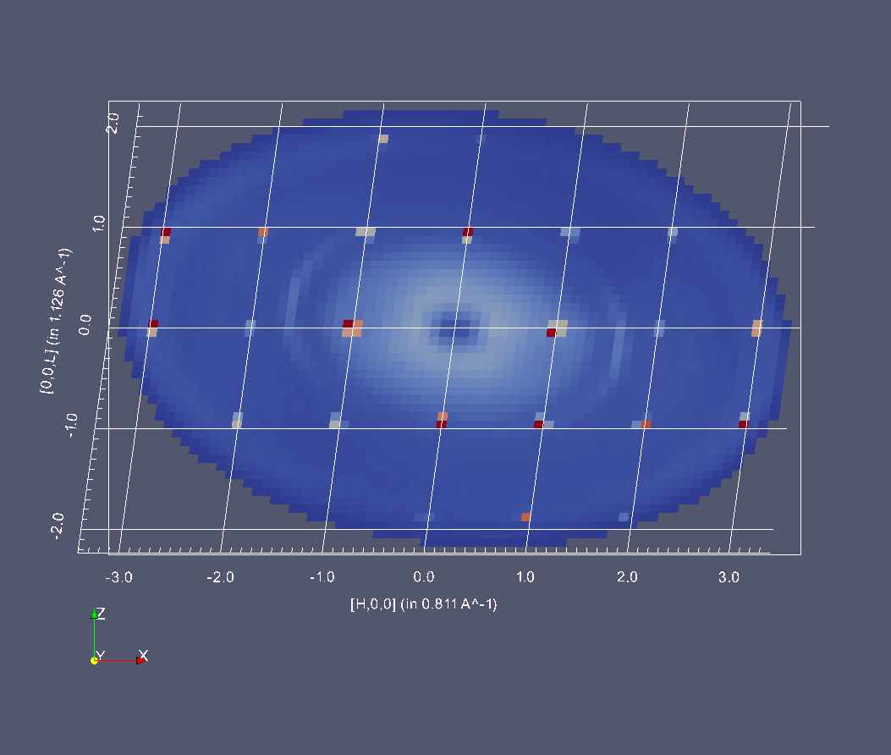
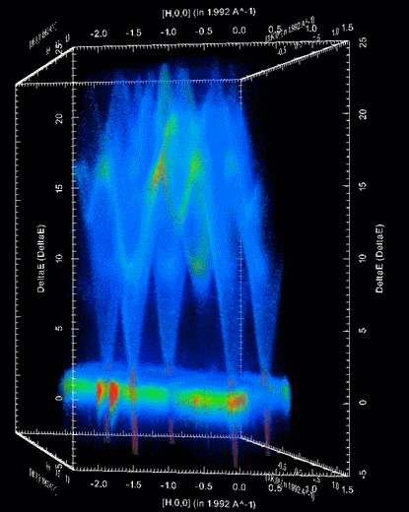
Non Orthogonal Projections
Notes:
We have built into the 3D visualisation the ability to switch between coordinate systems.
Quite a bit of work on the part of both Kitware and our team to achieve this. This was done as part of a larger piece of work, that involved us passing on some of our home-grown features to ParaView, as well as a number of changes on their side to improve the flexibility of some of their representations.
The B matrix is used to provide the transform from triclinic to orthonormal.
Figure 1: Br_PHCX_75_E0 measured where?
Figure 2: A non-orthogonal 3D projection of Spin Waves in Gd as measured on SEQUOIA.

Slide 10
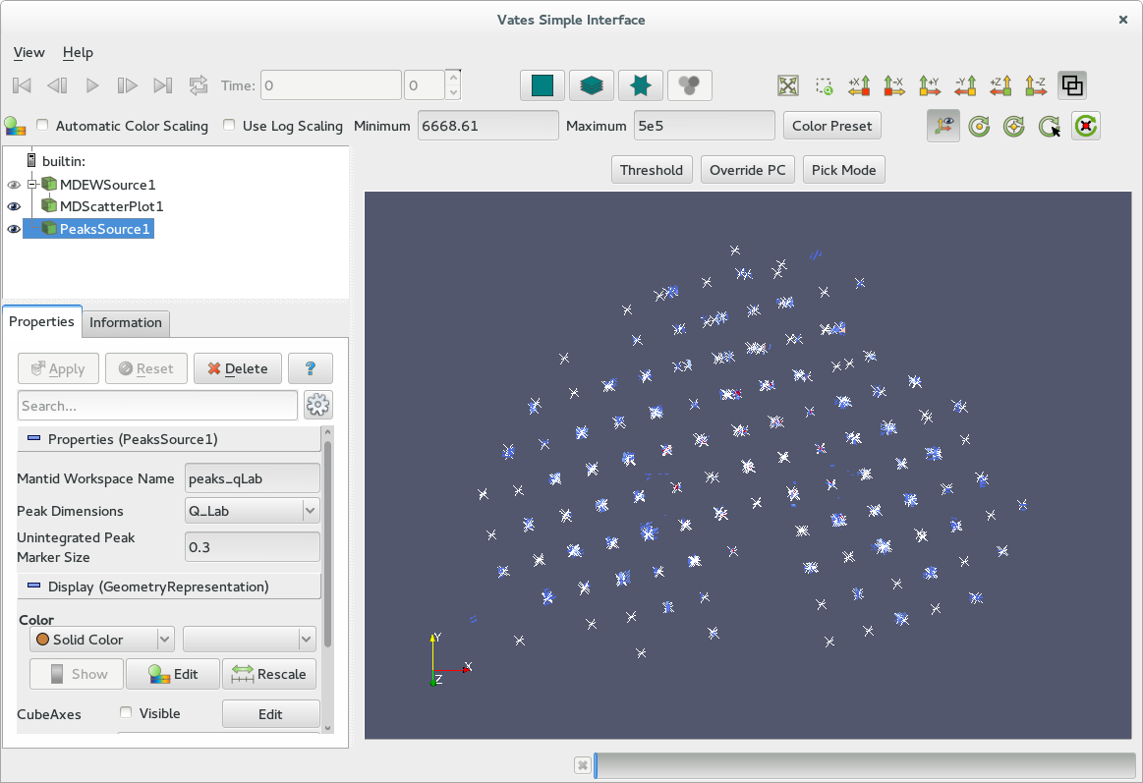
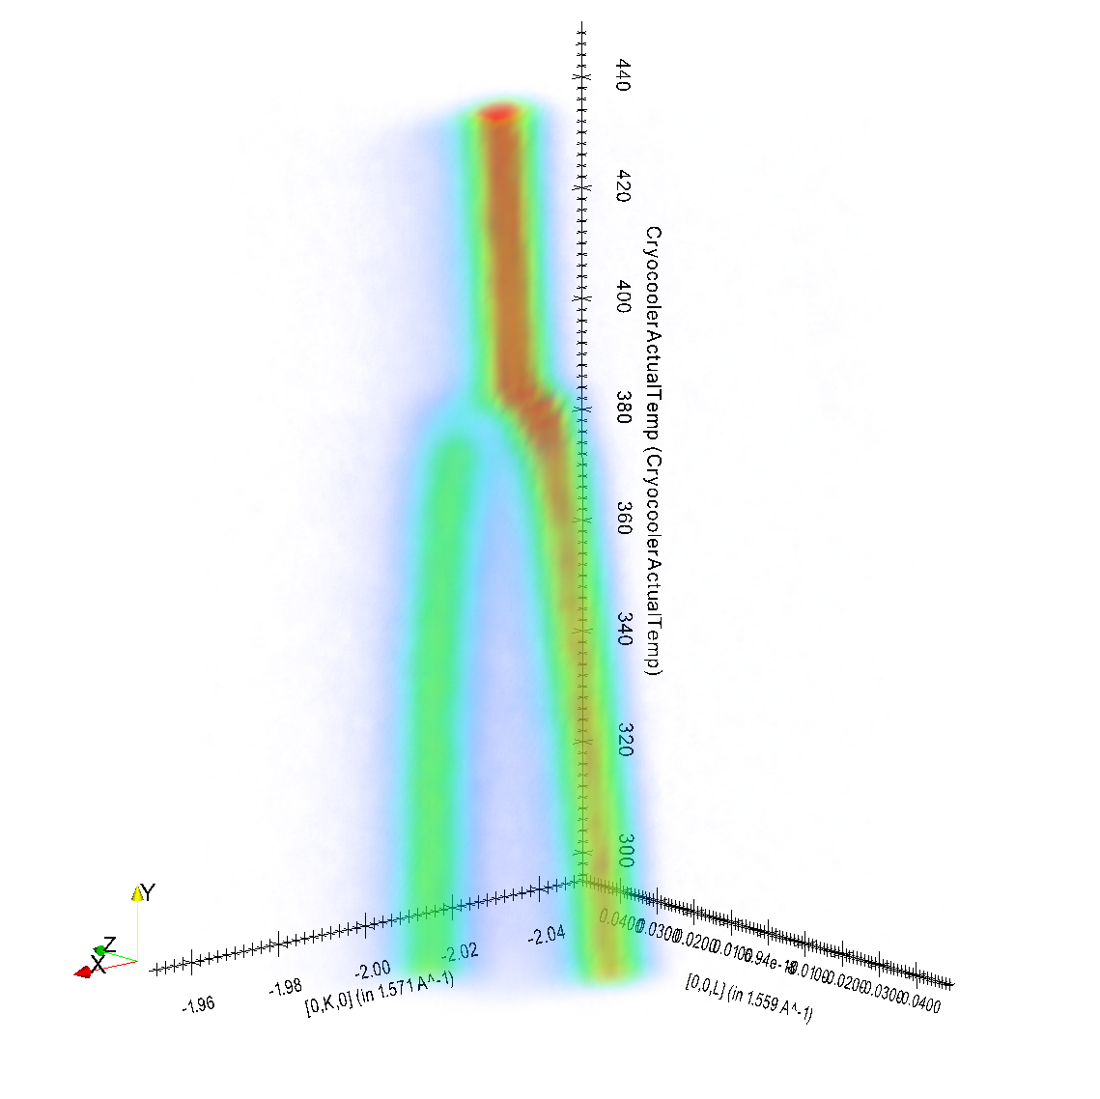
Notes:
Sodium chloride sample on SXD with overlayed SCD peak posiitons, automatically found via algorithms projected over the top of the data.
‘Tuning fork’ Phase transition. From data collected on TOPAZ.

Slide 11
Model Fitting
Visualisation ⬅➔ model fitting/simulation
Highly iterative procedure
Require seamless integration with Mantid and visualisation
Allow user-supplied models for scattering
‘foreground’: typically global across dataset + resolution
‘background’: simple (e.g. Linear background), no resolution
Fits in with existing Mantid Fit framework
Resolution/Foreground/Background models follow existing “plug-and-play” pattern:
Fit/Simulate works on common interface
Allows any number of resolution, foreground & background models to be defined

Slide 12
Component Overview
The main Mantid fit function
Background model
uses current Fit mechanism
ResolutionConvolvedCrossSection
MDResolutionConvolution
ForegroundModel
TobyFitResolutionModel
OtherResolution1
Model1
Model2

Slide 13
Foreground Models
Commonly added to/changed
Interface currently accepts models in C++
On going work to simplify process of users writing their own models:
Will provide template + scripts to control building new models against Mantid version (for all platforms)

Slide 14
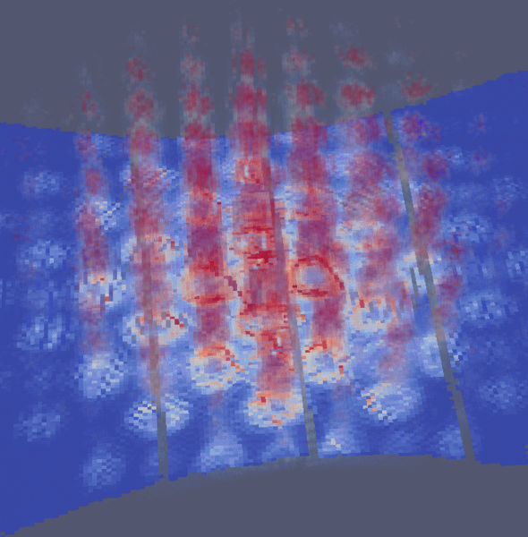
Model fitting: current status and forward view
Verify & expand stock foreground model library
Speed optimisation
User interface:
easy-to-use templates for simple user models
Work-bench interface
Distributed computing (clusters)
Possible investigation into using GPU resources
Other resolution function models
Interface with third-party code
McPhase
GULP
Simulation of MERLIN instrument resolution convolved with a Strontrium122 foreground model

Slide 15
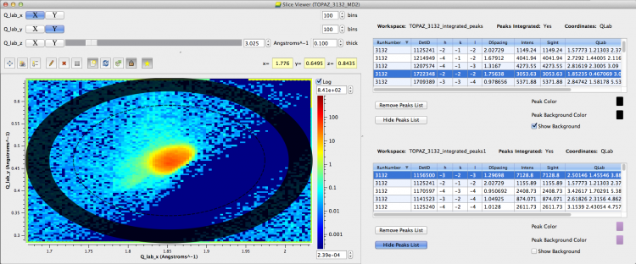
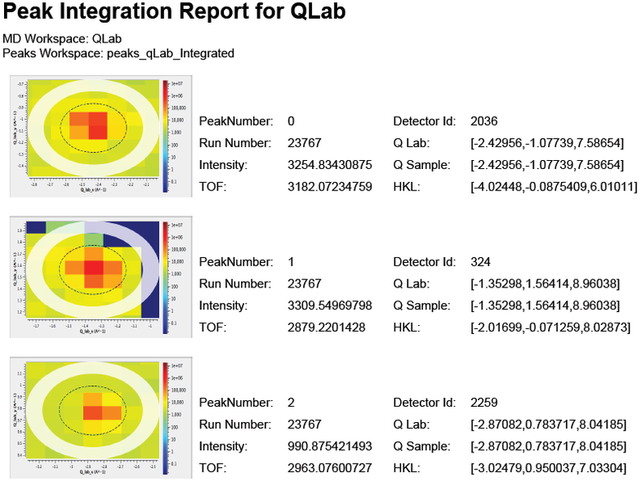
PeaksViewer
Notes:
Did your automatic peak finding algorithm do a good job? Did it miss peaks?
Did your peak integration algorithm select a suitable region for the integration?
Where are my most intense peaks?
PeaksViewer helps answer these questions.
Allows the user to navigate between the algorithm outputs and their location in Qspace.
Allows the user to overplot more than one peaks workspace at the same time.
Fully scriptable in python, which has allowed us to make peak report PDFs showing the location of each peak.

Slide 16

PeaksViewer
Notes:
Here’s an animation showing how the peaksviewer can be controlled in python. I use it to sort by the most intense peaks, then to look at the first 5 most intense peaks.

Slide 17
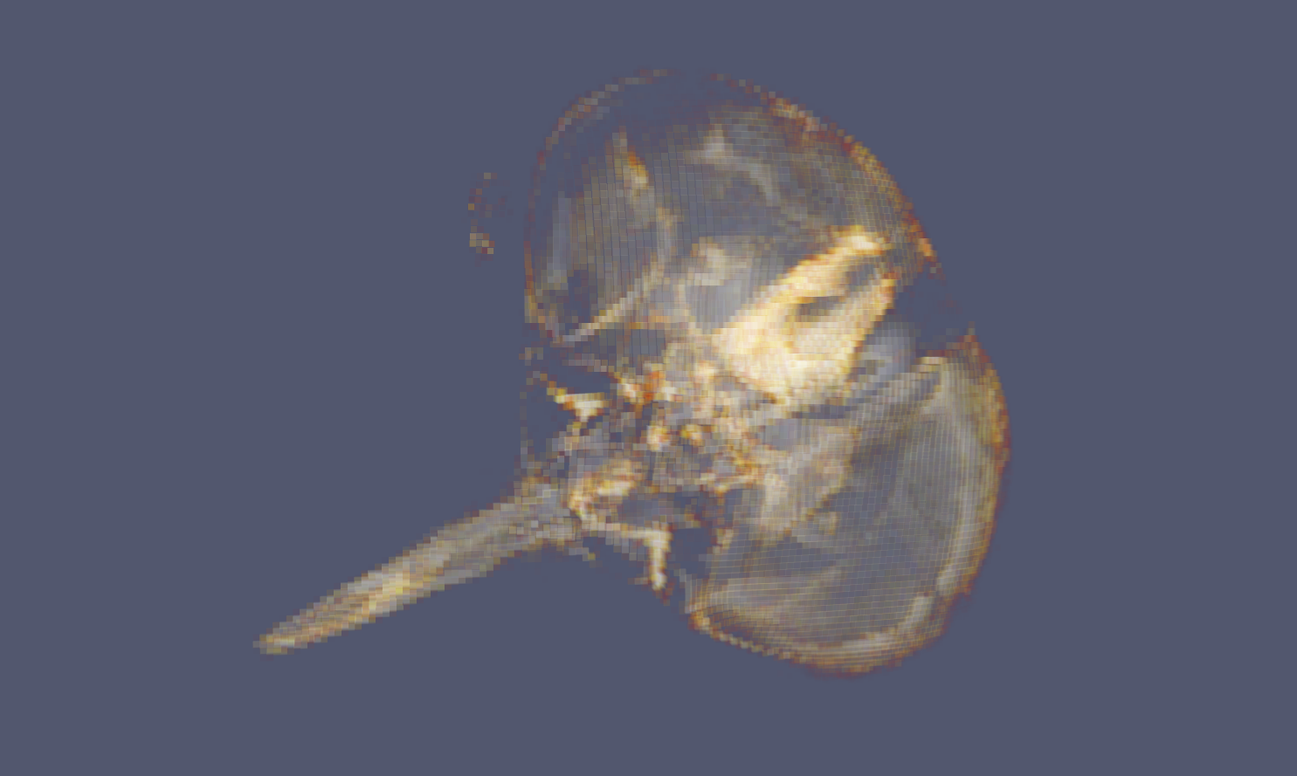
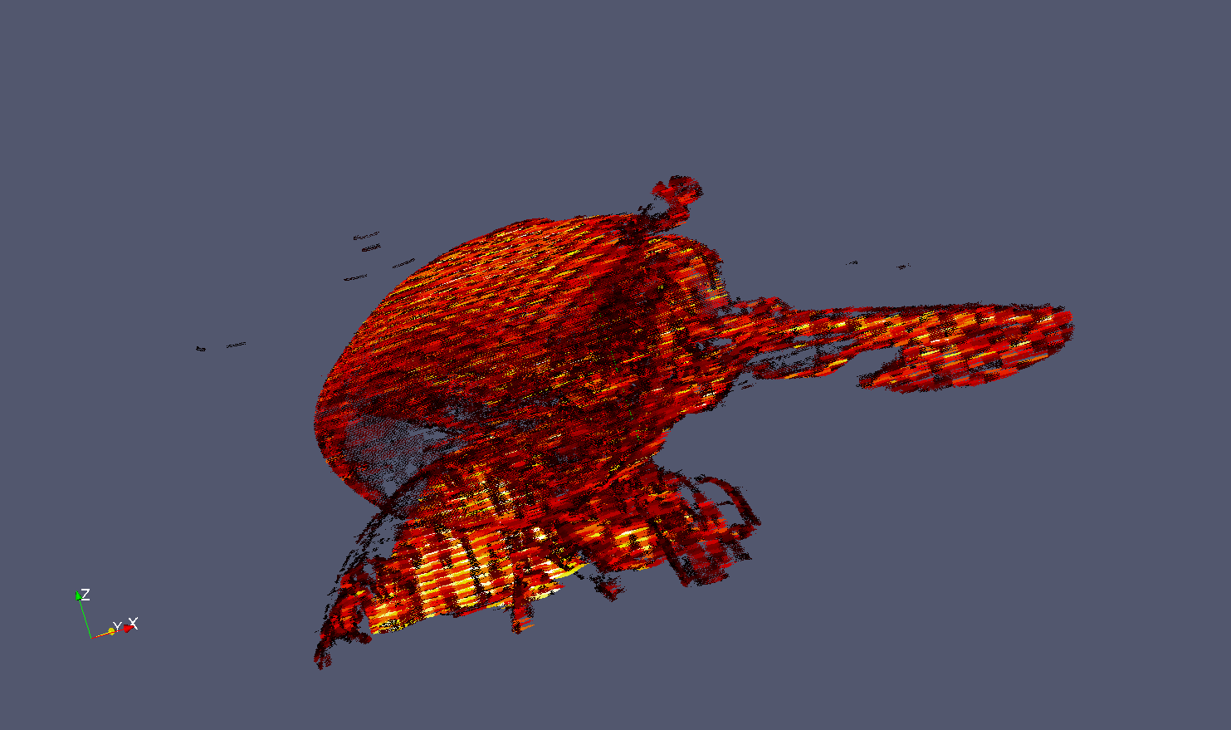
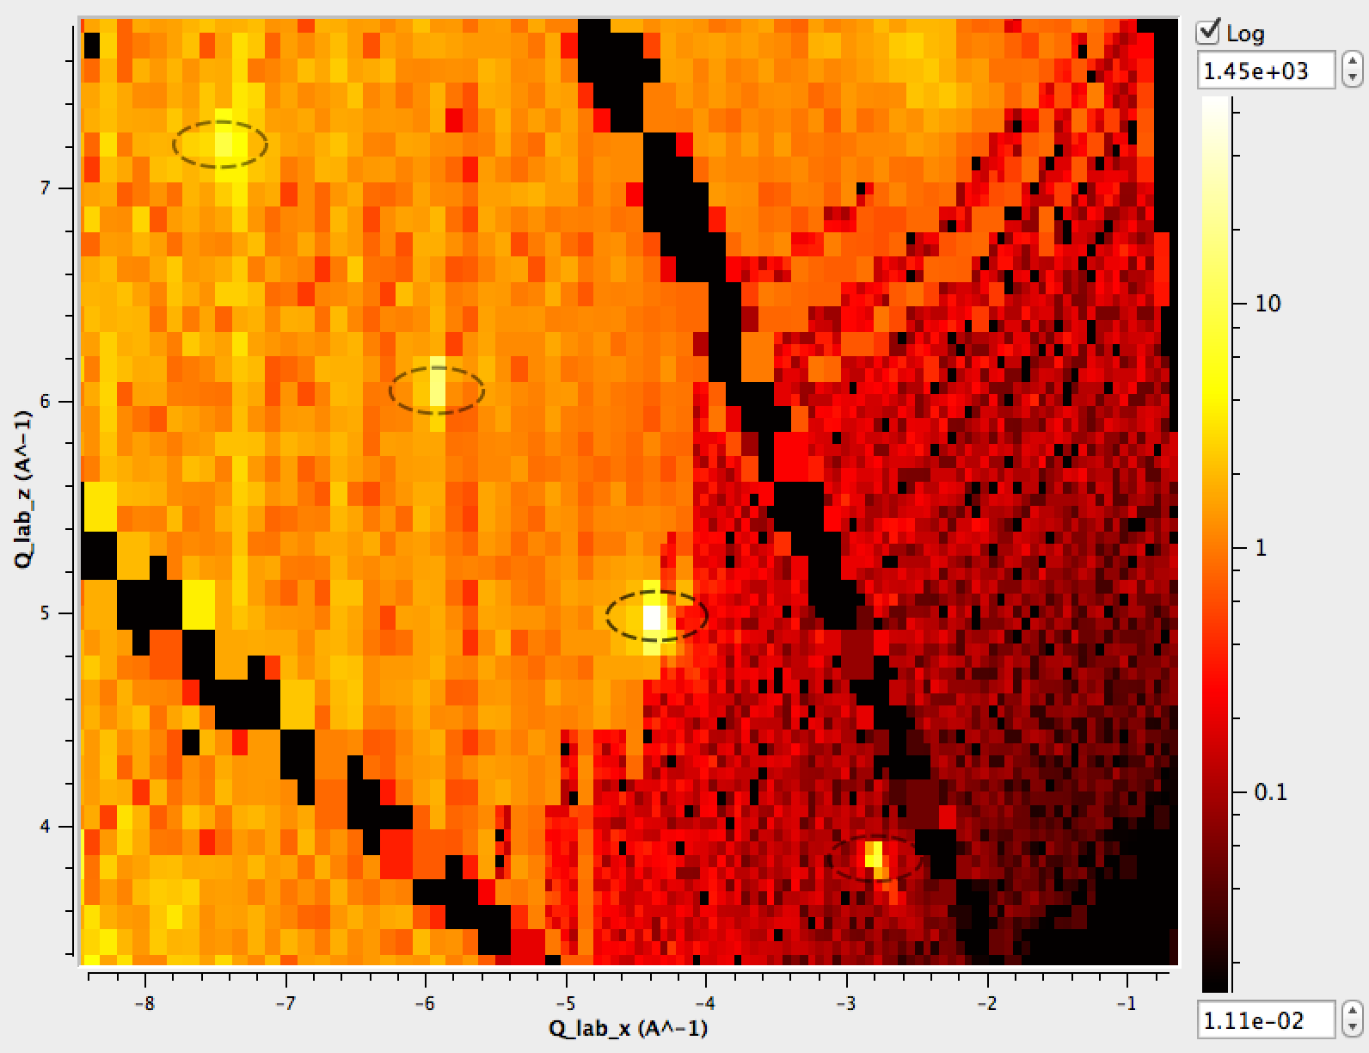
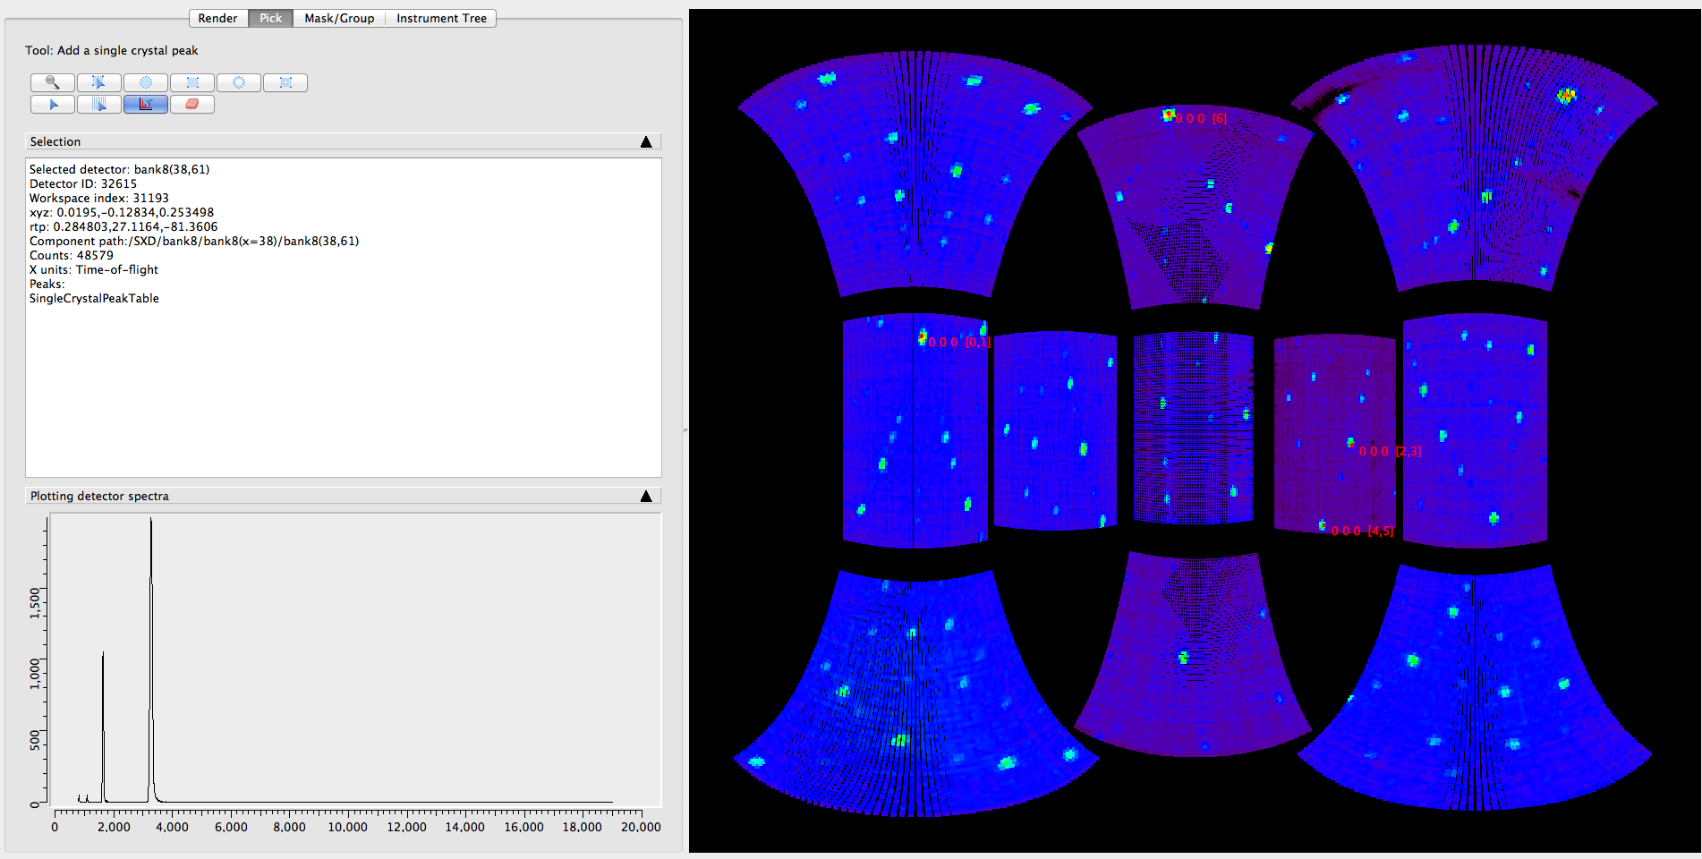
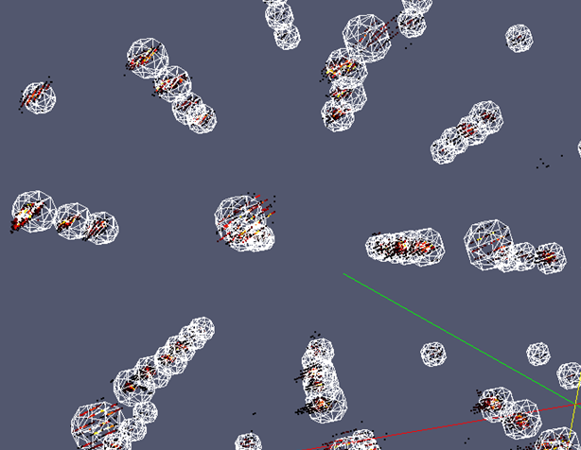
Two way interaction
Left: Slice through an multi-dimensional workspace in Q-lab. Algorithmic output fed into visualisation to show spherically integrated regions. Right: 3D representation of integration regions with Bragg peaks in Qlab. Both from cublic NaCl on SXD.
Notes:
There’s lots of examples of where the VATES features have been useful in Mantid and the reverse is also true.
Here are some examples.
Fly head (High resolution of the MDEventWorkspace, without the high memory cost). Sparse data.
Instrument view using MD Algorithms
QueryMDWorkspace
plotMD
PSI using Mantid
Connected Component Analysis

Slide 18
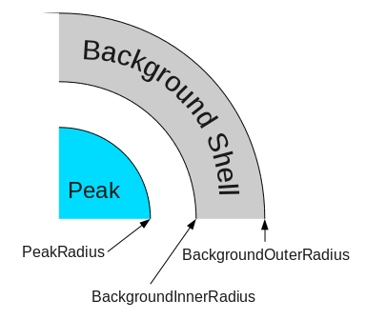
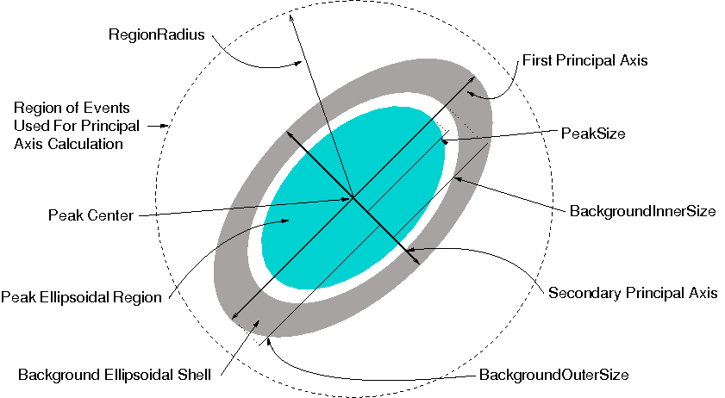
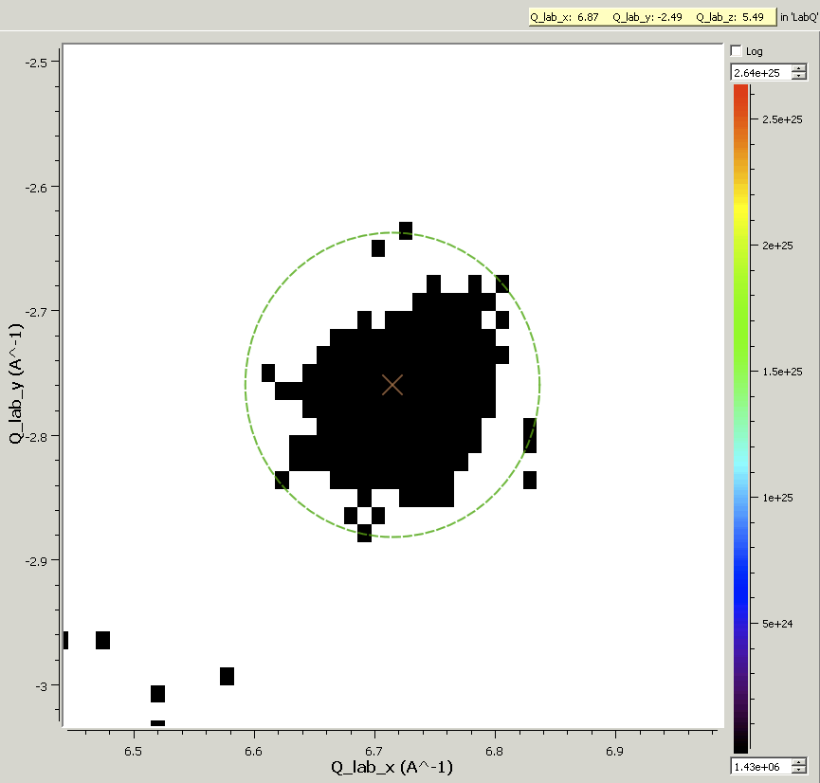
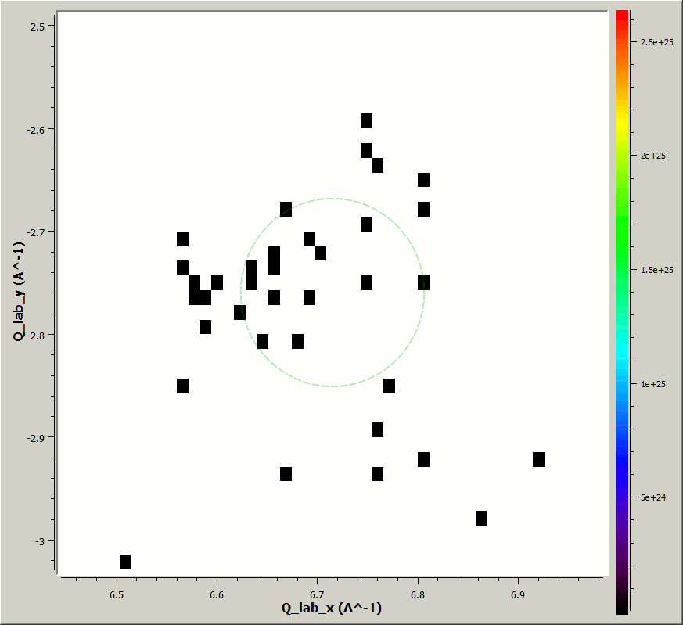
Peak Integration
Heavily uses both Mantid and VATES
Started out with a spherical integration algorithm
Ellipsoid integration
Experimenting with CCL approach
Notes:
Interesting test case.
Subject to a lot of interest by instrument scientists
Lots of possible ways of doing this
Inherent problem with determining peak shape
LC at ILL suggested using CCL
Implemented nD CCL (lean on the MDHistoWorkspace)
Implemented multi threaded CCL (lean on the MDHistoWorkspace)
First attempt, then most recent attempt. Still exploratory.

Slide 19
Things that have worked well
Drawing requirements from more than one facility
Having developers working on the project at each facility
Re-organising the team to be technique focused
Leaning on, and adding to an existing framework
Continuous integration with regular releases
Solving deployment issues early
Notes:
As a retrospective over the last 24 months, I’d like to highlight some of the things that have worked well.
We have continued our strong relationship with the SNS, not just in terms of the development team but also sharing requirements, and using the advice of the instrument scientists to shape the development.
It has therefore been useful to have developers working at each facility and providing a local point of contact.
To bridge the gap between developers and instrument scientists, we re organised the development team to have named developers responsible for supporting different technique areas, rather than technology areas. Helped improve communication.
We have seen some of the benefits to both Mantid and VATES of this two way interaction. In the early days, the benefit was far more weighted towards the VATES project, but we are increasingly seeing features flowing in the other direction.
Continuous integration with regular deployment has been critical to fast and regular deployments, without compromising quality.

Slide 20
Things we could have done better
Close collaboration with the users
Scriptability considerations first
Better strategic direction and view with dedicated resources
Notes:
No room for complacency here. Instrument scientists and developers have a shared responsibility to ensure that the product meets the requirements. When we are working under pressure, often with other responsibilities, the active communication can be a casualty.
Scriptability should have been a more urgent concern. It’s not just a case of exposing something to a scripting interface, it needs to be well thought out and cohesive.
This is the downside of having developers reporting to individual instrument scientists and groups, you can loose the higher level objectives. It’s hard to do both at the same time with the same set of resources.

Slide 21
MD Normalization

Slide 22
Looking Forwards
Complete scriptability. A well thought out API.
Better cohesion between tools.
MD normalization work.
Processing of large datafiles.
Turning our attention to MPI and GPU processing
Continued scientific led development
Notes:
Dump output of peak finding onto workspace, then move around in 3D to see how well its done.
Input from all directions whole other stories:
Dennis M. and peak searching
Horace
:
Hot off the presss: Md workspaces can be exported as numpy arrays (and v.v.)

